Slide 1
Credit Card Fraud Detection

Slide 2
AGENDA
Objective
Background
Key findings
Recommendations
Appendix:
Data sources
Data methodology

Slide 3
OBJECTIVE
Finex is a leading financial service provider based out of Florida, US. It offers a wide range of products and business services to the customers through different channels like in-person banking, ATMs and online banking.
In recent times, the number of fraud transactions has increased drastically due to which the company has been facing a lot of challenges.
For banking companies like Finex, retaining high profitable customers is the most important business goal. With the rise in digital payment channels, banking fraud, however, poses a significant threat to this goal for many banks.
As a consulting company hired by Finex, our task was to identify the root cause of this issue of unauthorized transactions on credit card/debit card and recommend ways to mitigate this problem.

Slide 4
BACKGROUND
Fraudsters steal credit card information using skimmers in ATM/POS terminals and make unauthorized transactions.
The Federal Trade Commission estimates that 10 million people are victims of credit card theft each year.
Credit card companies lose close to $50 billion per year to fraud.
These costs ‘trickle down’ to higher interest rates and fees for all consumers.
All cardholders pay for credit card fraud losses.
Victims spend time and money to repair the damage.
Credit card issuers charge higher fees and interest rates to cover their losses.

Slide 5
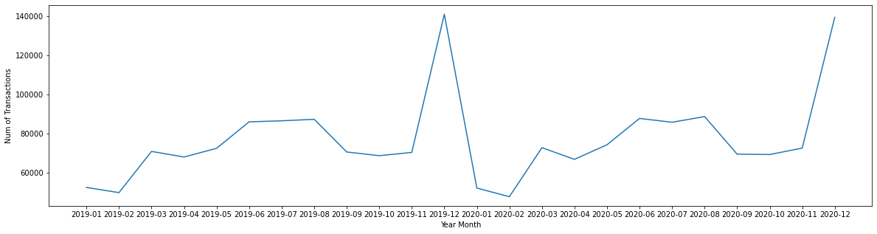
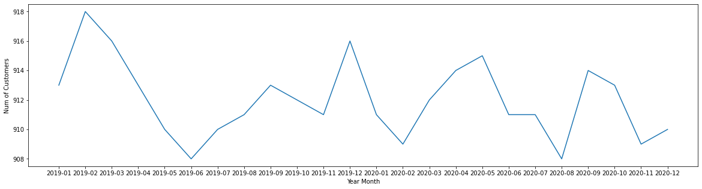
KEY FINDINGS
YEAR MONTH VS TRANSACTIONS AND CUSTOMERS
The timeline plot shows the number of transactions and the number of customers who made transactions in a given year month.
The number of transactions by ~900 customers ranges from 60k to 140k and changes every month.
The number of customers did not vary a lot. It shows that the same number of customers make multiple transactions, which is also a seasonal behavior. We see a peak in the month of December.

Slide 6
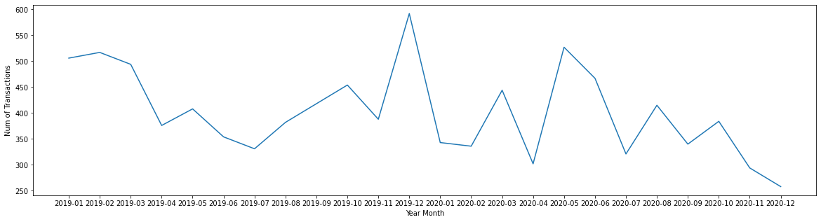
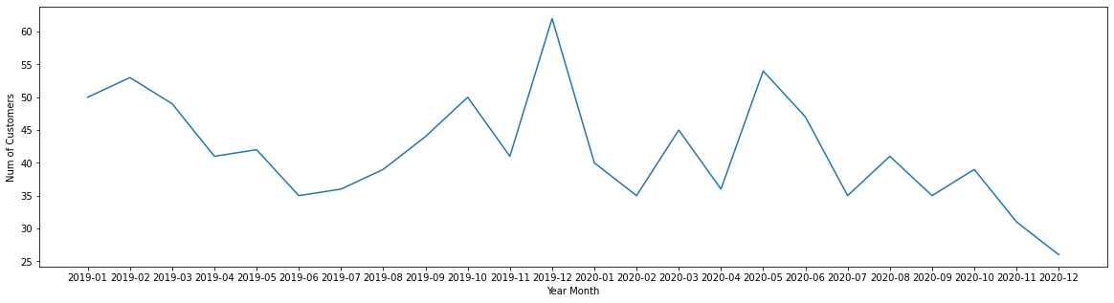
YEAR MONTH VS FRAUD TRANSACTIONS AND CUSTOMERS
The number of fraudulent transactions vary from 250 to 600. Fraudulent transactions are distributed across all months which shows fraud is a continuous behaviour.
Interestingly, in Dec -2020, there is a peak of overall transactions, whereas fraudulent transactions show a dip.
Fraudulent transactions are repeated for the same customers’ credit cards; for example, 500 fraudulent transactions were made with the same 50 customer’s credit cards in January 2019. Mostly, more than one fraudulent transaction occurred with the same customer’s credit card.

Slide 7
CATEGORICAL VARIABLE - GENDER
 | Gender | Is_Fraud | Count | Gender_Count | Percent_GRP
0 | F | 0 | 1009850 | 1014749 | 99.517221
1 | F | 1 | 4899 | 1014749 | 0.482779
2 | M | 0 | 832893 | 837645 | 99.432695
3 | M | 1 | 4752 | 837645 | 0.567305
Based on the ‘Gender’ variable, there is not much skewness based on the number of transactions in both groups.
The fraud percentage is approximately the same in both groups.
There is no bias of fraudulent transactions based on the gender of the credit card holders.

Slide 8
CATEGORICAL VARIABLE – MERCHANT CATEGORY
Category | Is_ Fraud | Count | Category_ Count | Percent | Percent_ GRP
Health_Fitness | 1 | 185 | 122553 | 6.615925 | 0.150955
Home | 1 | 265 | 174560 | 9.472067 | 0.151032
Food_Dining | 1 | 205 | 130729 | 7.057300 | 0.156813
Kids_Pets | 1 | 304 | 161727 | 8.730702 | 0.187971
Entertainment | 1 | 292 | 134118 | 7.240252 | 0.217719
Personal_Care | 1 | 290 | 130085 | 7.022534 | 0.222931
Travel | 1 | 156 | 57956 | 3.128708 | 0.269170
Grocery_Net | 1 | 175 | 64878 | 3.502387 | 0.269737
Misc_Pos | 1 | 322 | 114229 | 6.166561 | 0.281890
Gas_Transport | 1 | 772 | 188029 | 10.150594 | 0.410575
Shopping_Pos | 1 | 1056 | 166463 | 8.986371 | 0.634375
Grocery_Pos | 1 | 2228 | 176191 | 9.511529 | 1.264537
Misc_Net | 1 | 1182 | 90654 | 4.893883 | 1.303859
Shopping_Net | 1 | 2219 | 139322 | 7.521186 | 1.592713
The number of transactions varies between the categories (gas_transport, grocery_pos …. travel).
The fraud percentage (Ref percent_grp in table) also shows different levels based on the categories.
The category ‘Health_Fitness’ has a low percentage of fraudulent transactions, whereas the category ‘Shopping_Net’ has a high percentage of fraudulent transactions.

Slide 9
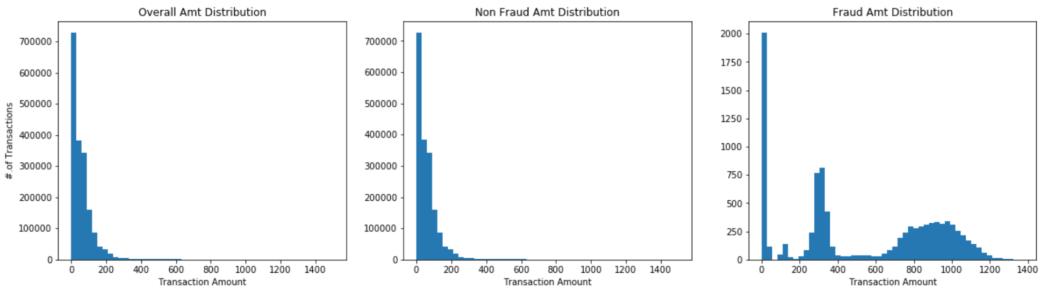
AMOUNT DISTRIBUTION
The distribution of ‘Amt’ for fraud transactions is quite different from the Overall Amt Distributions.
Fraudulent transactions are concentrated in ranges of [$1 - $10] , [$200 - $400] and [ $600 - $1,200] bill values. Fraudsters are mostly focusing on mid value range of Transaction Bill Value and not on very high-value Bill Value transactions as in ‘Non Fraud’ Transactions which is between $1,500 to $ 30,000].
*Note: Transactions Amt great then 1500 is removed in Overall and Non Fraud Plots for Just Visualizing the data distribution, which is 0.1% of the overall transactions.

Slide 10
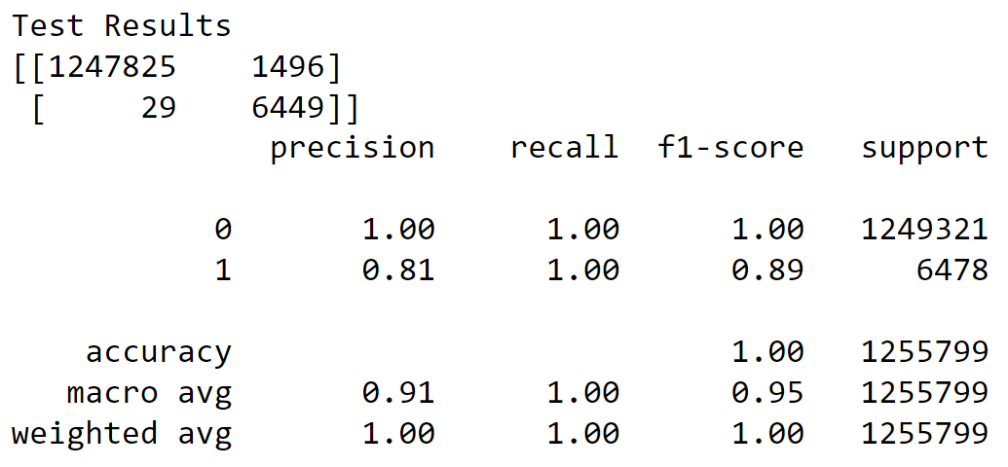
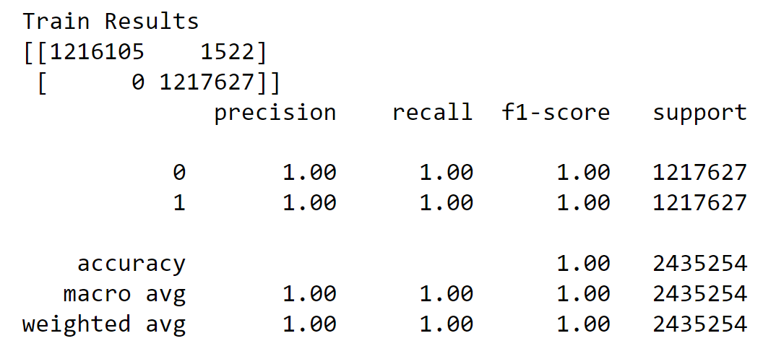
MODEL RESULTS – DECISION TREE
The decision tree model that has been built has good precision and recall in the train, but the precision is hugely dropped in the test data. This indicates the overfitting problem. So, we cannot use this model for the prediction of fraud transactions.
Note: Precision and recall need to be only evaluated on the minor class that is Fraud (1) in our case.

Slide 11
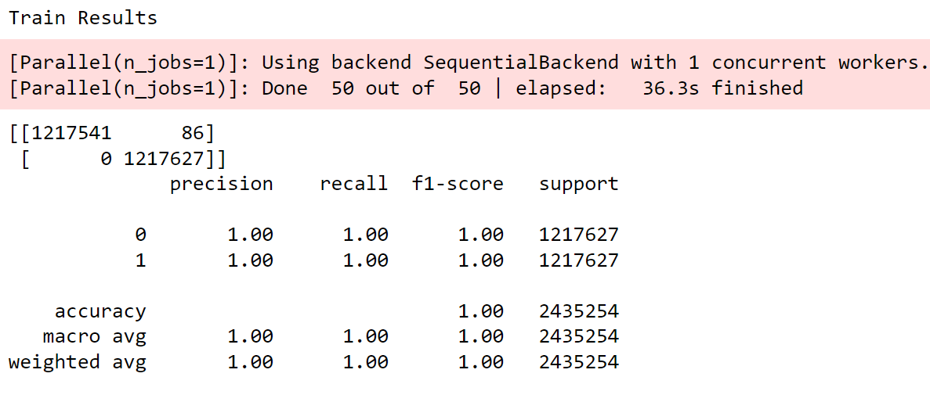
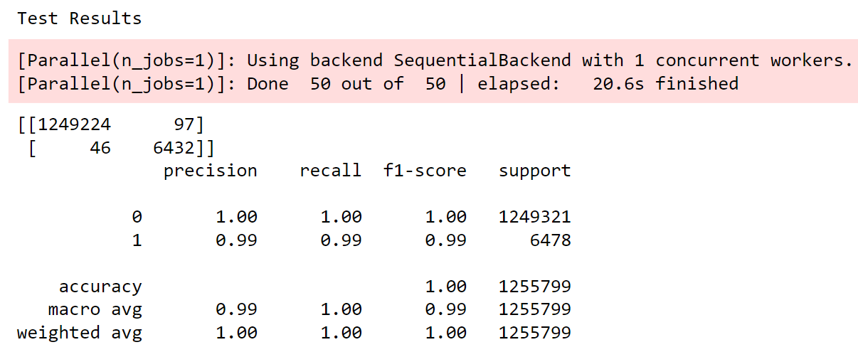
MODEL RESULTS – RANDOM FOREST
The random forest model has good precision and recall in the train and similar precision and recall in the test data. So, this model will be good fit in the prediction.

Slide 12
RECOMMENDATION
By default all the transactions detected as fraudulent by the model need to be blocked and a second layer of authentication needs to be added. Doing this prevents 99% of the fraudulent transactions from happening.
The costs incurred from the fraudulent transactions that were missed by the model and adding a second layer of authentication comes out to be $2733, which is just 1.3% of the original costs before the model was in place.

Slide 13
APPENDIX: DATA SOURCES
We have a simulated credit card transaction data set containing legitimate and fraudulent transactions from 1 January 2019 to 31 December 2020. Source: Kaggle
It covers credit cards of 1,000 customers doing transactions with a pool of ~700 merchants.
A transactional data usually contains the information of the customer, merchant, location variables, transaction date time, transaction amount and whether it is a fraud or not.

Slide 14
APPENDIX - PROBLEM SOLVING METHODOLOGY
Problem Solving Methodology
The approach for this project has been designed to follow the CRISP DM Framework. The various stages of the framework are represented below in a sequential flow:
1
2
3
4
5
Understanding the Business Data
Data Preparation & Feature Engineering
Exploratory Data Analytics & Visualization
Model Evaluation and Model Selection
Preparing Predictive Models & Determining Important KPIs

Slide 15
DEPENDENT VARIABLE
A dependent variable is the prediction variable on which you build the classification algorithm.
In our case, the dependent variable is ‘is_fraud’ that contain values [0,1] where 0 is non fraudulent, and 1 is a fraudulent transaction.
Most of the transactions are non fraudulent transactions. There are only 0.52% fraudulent transactions out of 1.8 Million overall transactions, which is a class imbalance problem.
Is Fraud | Num of Transaction | %.of Transactions
0 | 18,42,743 | 99.48
1 | 9,651 | 0.52

Slide 16
DERIVE TIME RELATED AND DISTANCE RELATED VARIABLES
In any transactional data, `transaction date time` is a variable. From this, you could derive many variables that can be used as features in the model and in data analysis.
In our current data model, we derived the following variables:
Date
Year Month
Day of Week
Hour of the Day
The `haversine distance` is derived using the merchant and customer location features.

Slide 17
HISTORICAL VARIABLES
The derived historical variables are given a Customer ID as a pivot key. The variable descriptions are as follows:
Customer’s number of transactions in the last 60 days, not including the day of the transactions
Customer’s average order value in the last 60 days, not including the day of the transactions
Customer’s number of transactions in the last 24 hours before the current transactions
Customer’s number of fraud transactions in the last 24 hours, not including the last 2 hours transactions because in real time, it takes generally 2 hours for customers to notice unauthorised transactions, raise a complaint with the bank and the data to get logged into the data store/table.

Slide 18
CORRELATION
The correlation between dependent variables and independent variables is extremely important to learn how dependent variable is affected with respect to the independent variables.
The variable ‘Historical Transaction in last 60 days’ is 56% correlated with the dependent variable ‘Is Fraud’.
‘Historical Fraud Transactions in the last 24 Hours’ is 77% correlated with the dependent variable ‘Is Fraud’, which indicates that fraudsters who steal credit card information make repeated transactions within a short period of time.

Slide 19
MODEL DEVELOPMENT
Different ML models are built based on 29 features, which are as follows:
Transaction-level features (Amt, Time, Category, Gender, etc.)
Categorical features are one-hot encoded.
Historical features of customers
Distance features
The model metrics that are used to evaluate the model’s performance are as follows:
Rather than aiming for overall accuracy of the entire data set, detecting most of the fraud cases (recall) is more important, whereas transactions called fraud to be mostly fraud cases (precision).
We also need to check the model’s performance both on the train and test sets. We need to ensure that the model performing similar on both based on the selected metrics.

Slide 20
APPENDIX: RECOMMENDATION
Bank’s Perspective:
Average number of transactions per month = 77183
Average number of fraudulent transaction per month = 402
Average amount per fraud transactions = ~$530
Cost incurred due to fraudulent transactions earlier = 530 * 402 = 213060
Cost incurred per month after the model is built and deployed = 2723
Final savings = Cost incurred before - Cost incurred after
= 213060 - 2723 = 210337 (98.7% savings!!)

